Slide 1
CLOUD PROJECT
PROJECT TITLE
Railway Wagon Overloading and Underloading Detection System using AWS services.

Slide 2
INTRODUCTION AND ABSTRACT
:
ABSTRACT:
INTRODUCTION
The railway wagon overloading and underloading detection project aims to enhance safety and efficiency in freight transport.
By integrating IoT devices with AWS services, real-time monitoring and analysis of weight distribution in railway wagons are enabled.
This proactive approach ensures compliance with weight regulations and optimizes operational efficiency, fostering a safer and more streamlined railway ecosystem.
The railway wagon overloading and underloading detection problem presents safety and efficiency challenges in freight transport.
To address this, we propose an IoT and AWS-based solution. Integrating weight sensors with AWS IoT Core, Lambda, and S3 enables real-time monitoring and analysis.
This proactive approach enhances safety, optimizes efficiency, and ensures regulatory compliance in railway operations.

Slide 3
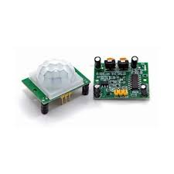
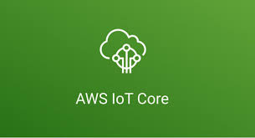
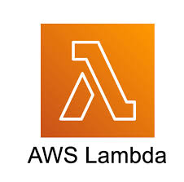
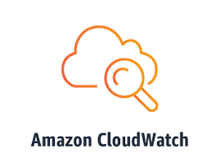

Architecture diagram

Slide 4
Proposed model
To detect railway wagon overloading and underloading, weight sensors are installed beneath each wagon corner, measuring weight distribution.
Data is collected by IoT devices, transmitted securely to AWS IoT Core, and processed using defined rules. AWS services like Lambda and S3 store and analyze data, triggering alerts via CloudWatch when thresholds are exceeded.
This system ensures real-time monitoring, preventing accidents, optimizing freight transport efficiency, and ensuring compliance with safety regulations.

Slide 5
USE CASES
DEPENDENCIES
Optimizes freight transport and minimizes delays.
Safety: Prevents accidents and infrastructure damage.
Compliance: Ensures adherence to weight regulations and avoids penalties.
Operations: Enhances operational insights and resource allocation.
Cost Savings: Reduces maintenance, insurance, and liability costs.
Environmental Protection: Mitigates ecological damage from overloaded wagons.
Hardware: Relies on weight sensors, microcontrollers, and IoT modules for data collection.
Connectivity: Depends on stable internet or network connections for data transmission to cloud services.
Cloud Services: Utilizes AWS IoT Core, Lambda, S3, and CloudWatch for data processing and storage.
Data Processing Algorithms: Requires accurate algorithms for detecting overloading and underloading based on weight thresholds.
Security Measures: Dependent on robust security protocols to protect data integrity and prevent unauthorized access

